Slide 1
Data Convergence
Vikrantsingh M. Bisen
Pridhvi Kodamasimham

Slide 2

Index
Need
Approach
Solution
Design Issues

Slide 3

Sample Open data
Format = Excel || xml || text
Tourism statistics
Year | Foreign Tourist Arrivals in Numbers | Foreign Exchange Earnings in Crores | Foreign Exchange Earnings in USD Millions | Domestic Tourist Visits in Numbers
Hotel statistics
Hotel name | Address | State | Phone | Fax | Email id | Website | Type | Rooms
Daily market price of commodity
<Table diffgr:id="Table413" msdata:rowOrder="412">
<State>Gujarat</State>
<District>Junagarh</District>
<Market>Junagadh</Market>
<Commodity>Beans</Commodity>
<Variety>Beans (Whole)</Variety>
<Arrival_Date>26/09/2012</Arrival_Date>
<Min_x0020_Price>1350</Min_x0020_Price>
<Max_x0020_Price>2000</Max_x0020_Price>
<Modal_x0020_Price>1625</Modal_x0020_Price>
</Table>
Burden! on App Developer
Data Cleaning
Different file format
Lack of consistency
E.g., Male – M or male
No standard set of dimensions
Difficult to aggregate data from different departments
No real time support

Slide 4

Solution (abstract view)
Data sources
……...
Upload files to system
xml/excel
Single point of input/output
Easy Access through API
Single universal format (JSON)
Flexible (select dimension as required)
Unified view
Support real time data
Data Convergent System
Get data in JSON format through API
……...
Mobile / web Apps

Slide 5

How stuffs work?
Challenges
No unique identifier
Finding correlation between different data sets
Different file formats
Different set of dimensions
Approach
Time as key
Overlapping
Object oriented view of data sets
Many independent data sets
Location as key
Technology Stack
RDBMS
NoSQL
JSON
Web Services

Slide 6
Data convergent system (a close view)
Upload files to system
xml/excel
……...
Data Source
Upload Form
Data
Repo.
Queue
ETL
Data warehouse
RDBMS
NoSQL DB
Cache / temporary view
API / Query Processor
Real time
CDC
API
Get data in JSON format through API
……...
Mobile / web Apps

Slide 7
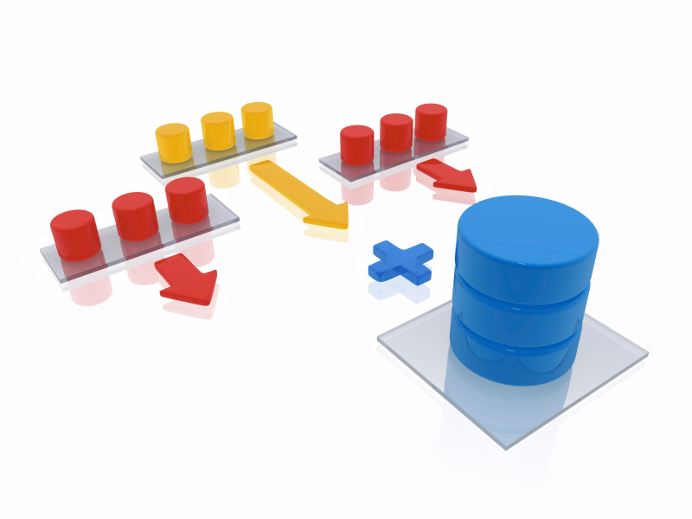
ETL
Granularity level
0-Country
1-State
2-District
Transform
Converting the addresses(0,1,2) to longitude and latitude.
Remove special char/whitespaces from keys/tags/col, trim, etc
Store
RDBMS
NoSql

Slide 8
Data warehouse
ID | Country | State | District | Department | MetaData / Data set name
1 | india | maha | mumbai | tourism | hotel
2 | india | maha | pune | Agriculture | Price of wheat
3 | india | ap | null | finance | Income tax collection
4
5
3 : { 1: { year: 2010, rupees: 500 in cr
}
2 :{ year : 2011,
rupees:600 in cr
}…….
} 4 : { crop : wheat, price: 500
…..
} ………….
Schema Less DB (MongoDB) 1 : { 1: { name : Taj, rooms : 400
rent : 5k
}
2: { name : OM, rooms : 300
rent : 3k
} …..
} 2 : { crop : wheat, price: 500
…..
}….....
Q. How to resolve Non uniform naming convention for place ?
e.g., Maharashtra – MH, MS,
=> Replace Location by latitude & longitude coordinates

Slide 9
Data flow
<Table diffgr:id="Table413" msdata:rowOrder="412">
<State>Gujarat</State>
<District>Junagarh</District>
<Market>Junagadh</Market>
<Commodity>Beans</Commodity>
<Variety>Beans (Whole)</Variety>
<Arrival_Date>26/09/2012</Arrival_Date>
<Min_x0020_Price>1350</Min_x0020_Price>
<Max_x0020_Price>2000</Max_x0020_Price>
<Modal_x0020_Price>1625</Modal_x0020_Price>
</Table>
<Table diffgr:id="Table413" msdata:rowOrder="412">
<State>Maharashtra</State>
<District>pune</District>
<Market>pune</Market>
<Commodity>Beans</Commodity>
<Variety>Beans (Whole)</Variety>
<Arrival_Date>26/09/2012</Arrival_Date>
<Min_x0020_Price>2350</Min_x0020_Price>
<Max_x0020_Price>3000</Max_x0020_Price>
<Modal_x0020_Price>3625</Modal_x0020_Price>
</Table>
Agri
Input
Data sets
Year | Foreign Tourist Arrivals in Numbers | Foreign Exchange Earnings in Crores | Foreign Exchange Earnings in USD Millions | Domestic Tourist Visits in Numbers
2008 | 5282603 | 51294 | 11832 | 563034107
Tourism
Hotel name | Address | State | Phone | Fax | Email id | Website | Type | Rooms
Taj | India gate mumbai | maharashtra | 876876 | 987976 | a@a.com | Taj.com | Ac | 500

Slide 10
Dataset upload form
Department
Agri
Country :
Single
Multiple
Data set Name
Name / col Name :
Data
Repository
Granularity
State :
Single
Multiple
Input
Data sets
Name / col Name :
File Format
District :
Single
Multiple
Upload
Browse
Tourism
Name / col Name :
Save
Submit

Slide 11
Data
Repo.
ETL
File parser
Data Cleaning / Transform
Store
RDBMS
ID | Country | State | District | Department | MetaData / Data set name
1 | india | maha | mumbai | tourism | hotel
2 | india | maha | pune | Agriculture | Price of wheat
3 | india | ap | null | finance | Income tax collection
4
5
3 : { 1: { year: 2010, rupees: 500 in cr
}
2 :{ year : 2011,
rupees:600 in cr
}…….
} 4 : { crop : wheat, price: 500
…..
} ………….
NoSQLDB
1 : { 1: { name : Taj, rooms : 400
rent : 5k
}
2: { name : OM, rooms : 300
rent : 3k
} …..
} 2 : { crop : wheat, price: 500
…..
}….....

Slide 12
Sample api
Input query
Getdata.php? department=“agriculture” & datasetname=“wheat prices, jute”& state=“Maharashtra” & city=“pune”
Sample JSON output
Agriculture : { wheat prices: [ { date: 2010, max: 500
min: 400 ,…..
},
{ date: 2011, max: 700
min:600 ,….
}, ……
]
jute prices: [ { date: 2010, max: 300
min: 200 ,…..
},
{ date: 2011, max: 600
min:400 ,….
}, ……
]…….
}

Slide 13

Sample Query which we can process
List all state which has paid income tax more than 10 cr
Find crop prices in hyderabad
Display all 5 star hotels in Bangalore
Find sum of all income from foreign tourist year wise
Total count Govt. hospitals state wise

Slide 14

Sample apps which can be built over it
Daily market price
Plan your travel
Find nearest Place (hotel/hospital)
Weather condition
General knowledge/Educational App

Slide 15

Modelling/Design Issues
Mongo DB Limitations
Max size of document – 16MB
Max number of collection +indexes = 24000
Max nesting level – 100
Approach - Semi-structured data (heterogeneous collection)
So each department mapped to collection as department cannot be more than few thousand
Each record is mapped to document
Query at 1 level is faster than nth level nested document
No ACID at collection level but at Document level
We are dealing with only one time insert and ‘n‘ select operations only
No join
Can do at application level, but cost/complexity?
Support built in map-reduce function, merge, etc
Optimization
Indexing
Sharding
Reduce dataset size

Slide 16


